Slide 1
Metagenomics
2025-04-23

Slide 2
Outline
Metagenomics
NCBI interface
Kraken2
Visualization (Krona)
📜

Slide 3
Metagenomics

Slide 4
Goal of metagenomics
Extract sample from environment
Sequence all DNA in the sample
What species are in the sample?
Public health uses
National Wastewater Surveillance System (NWSS)
Many other uses

Slide 5

NWSS - National Wastewater Surveillance System
Works with health departments to monitor wastewater
People shed DNA into wastewater
NWSS sequences DNA
NWSS contextualizes trends, current virus levels, and changes over time
Interpretation limited by fragmented genomes, low sensitivity relative to PCR, potential variation in shedding dynamics between variants

Slide 6
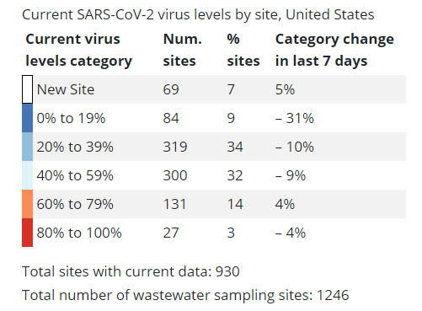
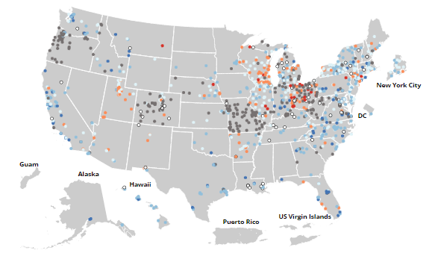
Participating sites
https://covid.cdc.gov/covid-data-tracker/#wastewater-surveillance, downloaded 11/15/2022

Slide 7
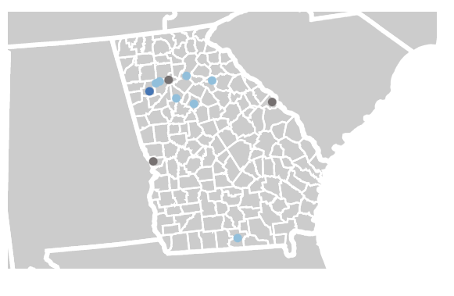
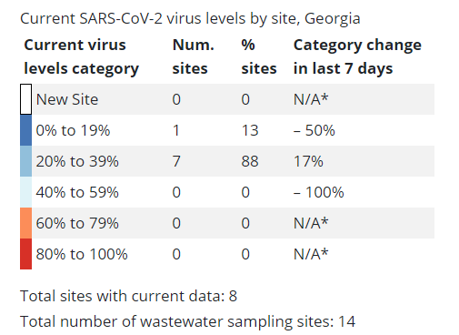
Zoom into Georgia

Slide 8
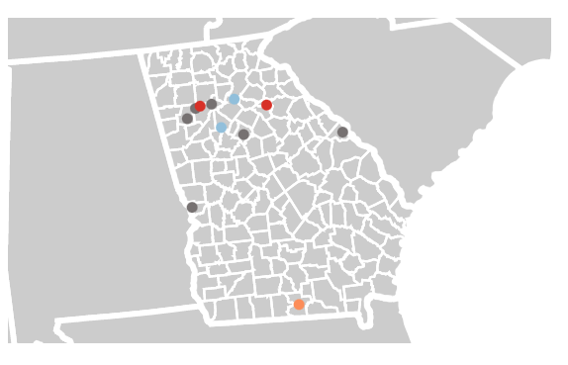
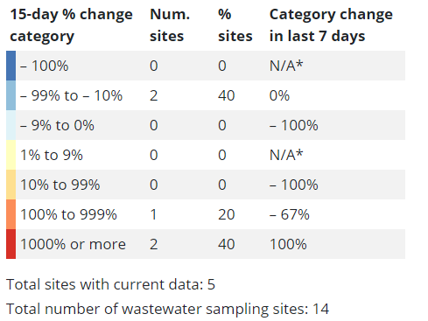
Percent change in the last 15 days by site, GA

Slide 9
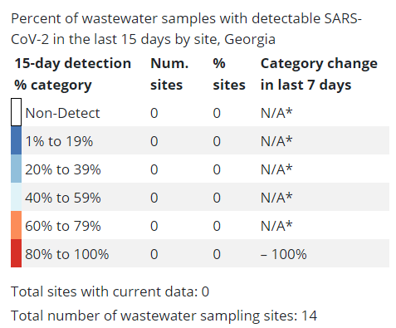
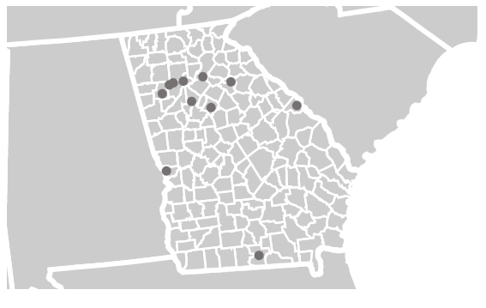
Percent of wastewater samples with detectable SARS-CoV-2 in the last 15 days

Slide 10
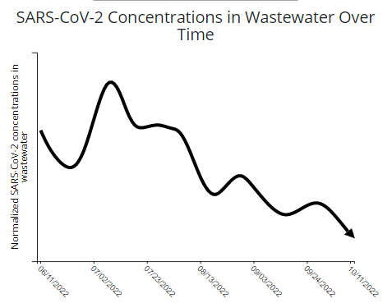
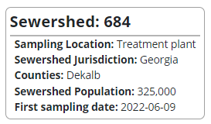
SARS-CoV-2 concentrations in wastewater over time

Slide 11
NCBI interface

Slide 12
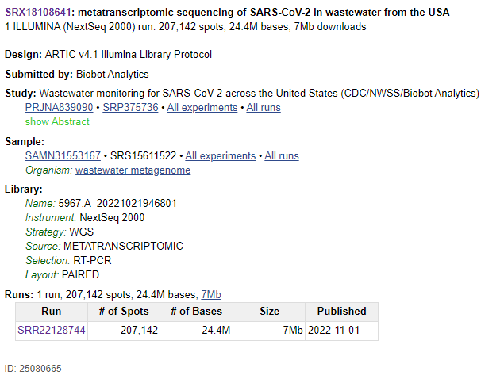
Wastewater
https://www.ncbi.nlm.nih.gov/sra/SRX18108641[accn]
click into the run accession

Slide 13
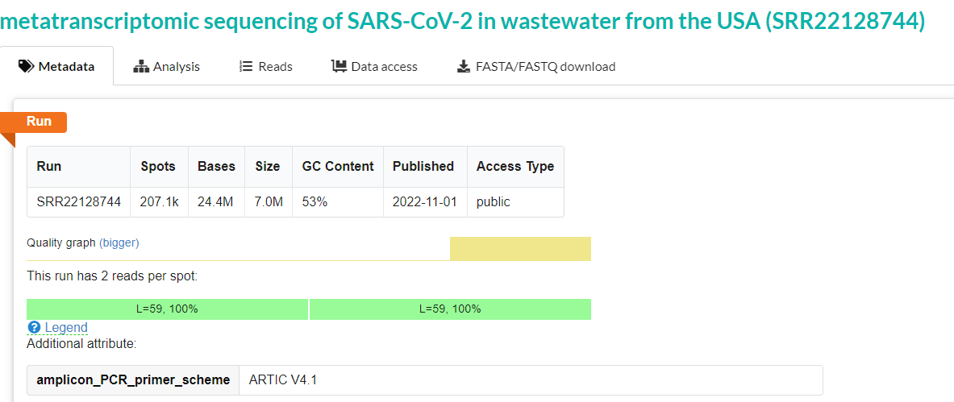
Learn from this accession
Click into the analysis tab

Slide 14
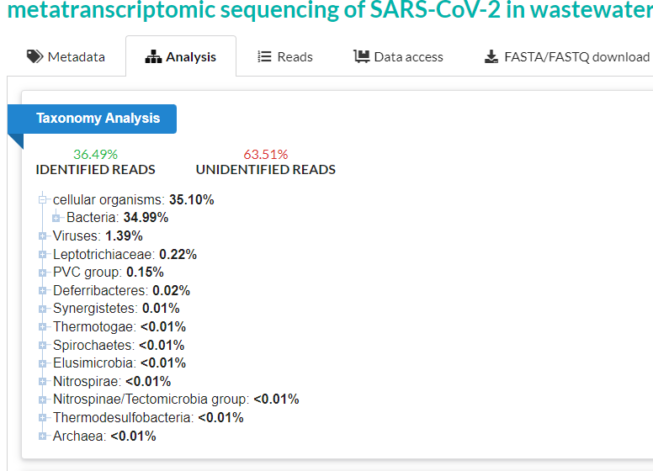
Learn from this accession
What do we have in this sample?
Expand a few of the categories
How many of the reads are not identified?

Slide 15
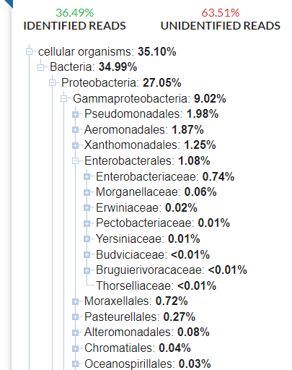
Gammaproteobacter
Includes foodborne bacteria like E. coli and Salmonella
Not necessarily pathogenic
This sample has very few Enterobacteriaceae which is good ☺

Slide 16
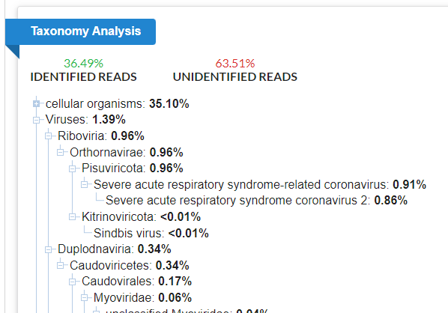
Viruses
Seems to have 0.86% SARS-CoV-2
How bad is that?
Notes:
How bad is that?
Unclear how many people might have it from looking at wastewater
We know that at least one person is probably shedding it

Slide 17
Download the fastq file for later
export PATH=$PATH:~/bin/sratoolkit.3.0.0-ubuntu64/bin
mkdir ~/fundamentals/metagenomics
cd ~/fundamentals/metagenomics
SRR=SRR22128744
fasterq-dump $SRR --threads 1 --outdir reads/$SRR --split-files --skip-technical
gzip reads/SRR22128744/SRR22128744_*.fastq -v

Slide 18
Kraken2

Slide 19
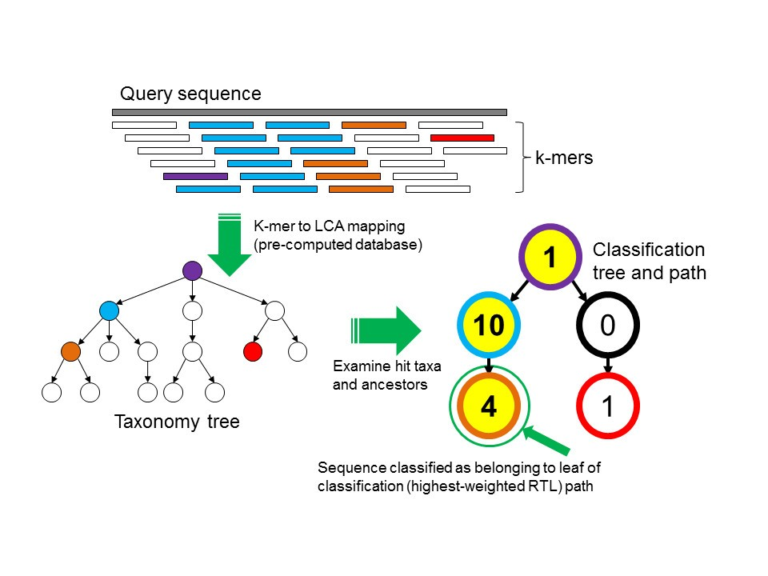
How Kraken works: build database
Notes:
genome assemblies from many different species
Generate kmers and associate them with taxonomy
Sometimes a kmer will associate with multiple nodes on the taxonomy
Find the last common ancestor between those nodes
Associate the kmer with that LCA
Result: database with kmers whose values are taxonomy IDs (taxids).

Slide 20
How Kraken works: query database
Read kmers in assembly or raw reads file (fasta or fastq)
Match them in kmer Kraken database
Find taxid per kmer
Apply taxid from kmers back to read or contig
Make an educated guess on what the taxid is for the read or contig

Slide 21
Kraken result file
562 562 562 562 562 561 561 A A A A A A A A A A 0 562 562 562
562:5 561:2 A:10 0 0:1 562:3
Denominator is 5+2+1+3 = 11
For 562, numerator is 5+3=8
For 561 (parent of 562), numerator is 5+2+3=10
If we set a threshold > ½, then 8/11 is greater than and the taxon is identified as 562.
If we set a threshold > 8/11, then 562 is not applied but 561 is (10/11).
Notes:
Every single read gets an identifier according to kmer matches and a score threshold

Slide 22
Create the environment and the database
mkdir fundamentals/metagenomics
cd fundamentals/metagenomics
mamba create -n kraken2 kraken2 krona
wget https://genome-idx.s3.amazonaws.com/kraken/minikraken2_v2_8GB_201904.tgz
tar zxvf minikraken2_v2_8GB_201904.tgz
rm minikraken2_v2_8GB_201904.tgz
This database is prebuilt
Other kraken databases can be found at https://benlangmead.github.io/aws-indexes/k2
Notes:
Other kraken databases can be found at https://benlangmead.github.io/aws-indexes/k2

Slide 23
Query the database
kraken2 --db minikraken2_v2_8GB_201904_UPDATE --threads 2 --report kraken2.report --gzip-compressed reads/SRR22128744/SRR22128744_1.fastq.gz reads/SRR22128744/SRR22128744_2.fastq.gz
--db database
--threads multithreading; use multiple cpus
--report filename for report
--gzip-compressed the reads are compressed (we did this in an earlier slide with gzip)
Notes:
--db database
--threads multithreading; use multiple cpus
--report filename for report
--gzip-compressed the reads are compressed (we did this in an earlier slide with gzip)

Slide 24
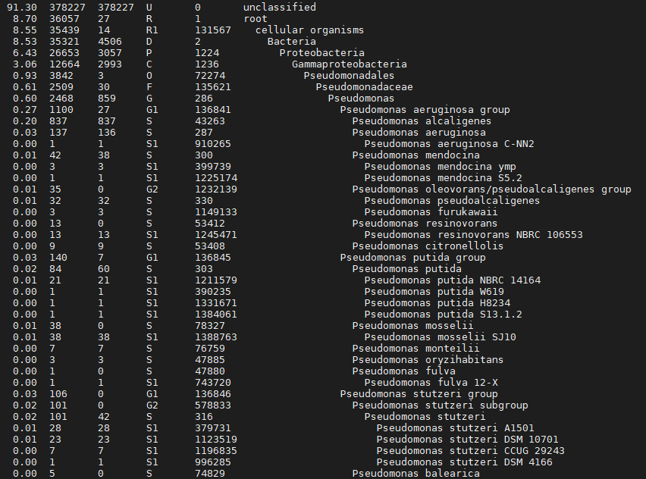
Output file kraken2.report
Notes:
Each row shows a taxonomy string going from kingdom down to species (or futher!). And the number of reads after the string.

Slide 25
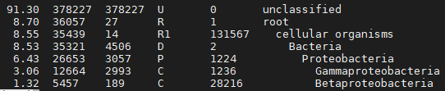
Output file kraken2.report; remove zero % categories
Why are we only seeing a few taxa??
Notes:
A: This database was created before the pandemic.
This is an abbreviated database; does not contain everything anyway
Additionally this is not the same tool as what’s on NCBI; results will vary.

Slide 26
Visualize with Krona

Slide 27
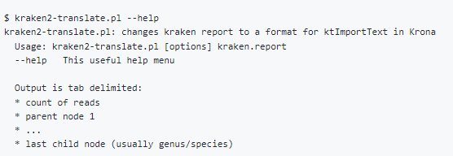
Download Dr. Katz’s script
wget https://raw.githubusercontent.com/lskatz/lskScripts/master/scripts/kraken2-translate.pl
perl kraken2-translate.pl kraken2.report > kraken2.tsv
Notes:
We need to modify the output of kraken2 into something useful.
We will run this script using `perl` and outputting it into kraken2.tsv

Slide 28
Kraken2 text from Dr. Katz’s script
(kraken2) gzu2@L355901:~/fundamentals/metagenomics$ head kraken2.tsv
378227 unclassified
27 root
14 root cellular_organisms
4506 root cellular_organisms Bacteria
3057 root cellular_organisms Bacteria Proteobacteria
2993 root cellular_organisms Bacteria Proteobacteria Gammaproteobacteria
3 root cellular_organisms Bacteria Proteobacteria Gammaproteobacteria Pseudomonadales
30 root cellular_organisms Bacteria Proteobacteria Gammaproteobacteria Pseudomonadales Pseudomonadaceae
859 root cellular_organisms Bacteria Proteobacteria Gammaproteobacteria Pseudomonadales Pseudomonadaceae Pseudomonas
27 root cellular_organisms Bacteria Proteobacteria Gammaproteobacteria Pseudomonadales Pseudomonadaceae Pseudomonas Pseudomonas_aeruginosa_group

Slide 29
Import into Krona
$ ktImportText -o kraken2.html kraken2.tsv
$ firefox kraken2.html

Slide 30
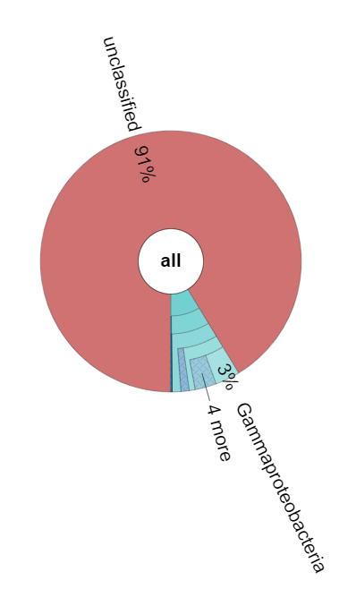
First glance at Krona

Slide 31
Words of caution
Select sources
Robert Petit PBEE Seminar 2018 https://docs.google.com/presentation/d/1_oEZ7bigebXslTRu_jplUHfW07I0tePuL-JjS38CGUQ/edit#slide=id.p17
Sam Minot 2016 https://www.onecodex.com/blog/2016/01/11/cautious-metagenomics-anthrax/
Afshinnekoo et al 2015 https://www.sciencedirect.com/science/article/pii/S2405471215000022
Mason 2015 https://microbe.net/2015/02/17/the-long-road-from-data-to-wisdom-and-from-dna-to-pathogen/
http://lab.loman.net/2015/02/11/metagenomics-best-hit-analysis-caveat-emptor/

Slide 32
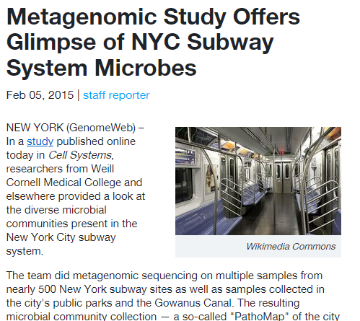
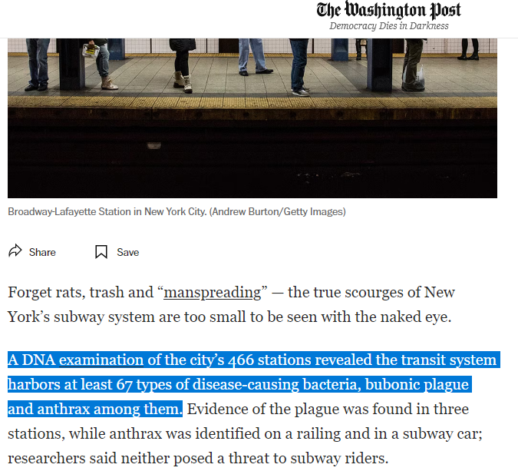
“anthrax” and “bubonic plague” found in NYC subway
https://www.genomeweb.com/genetic-research/metagenomic-study-offers-glimpse-nyc-subway-system-microbes
https://www.washingtonpost.com/news/morning-mix/wp/2015/02/06/from-beetles-to-bubonic-plague-bizarre-dna-found-in-nyc-subway-stations/

Slide 33
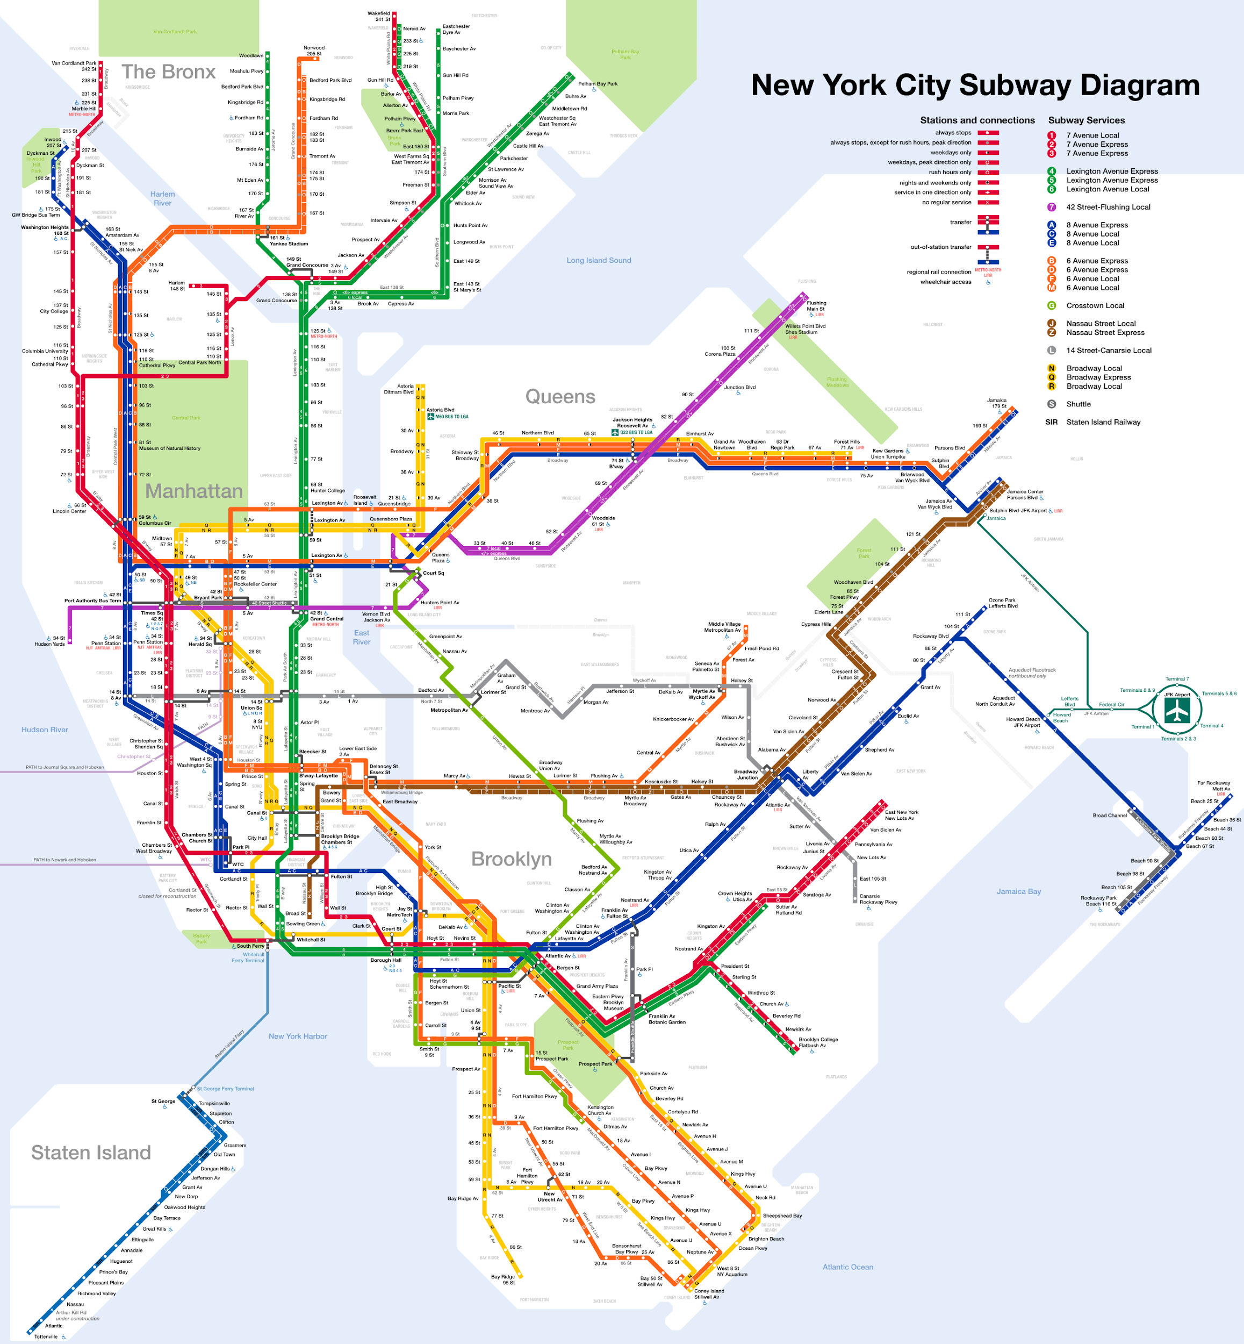
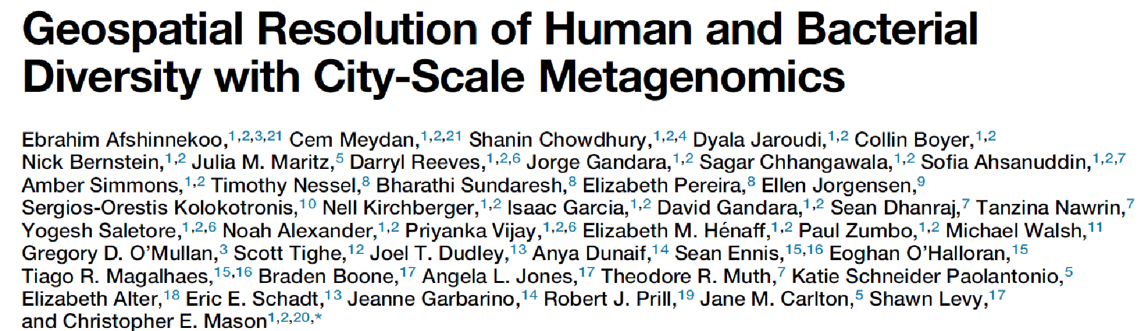

Slide 34
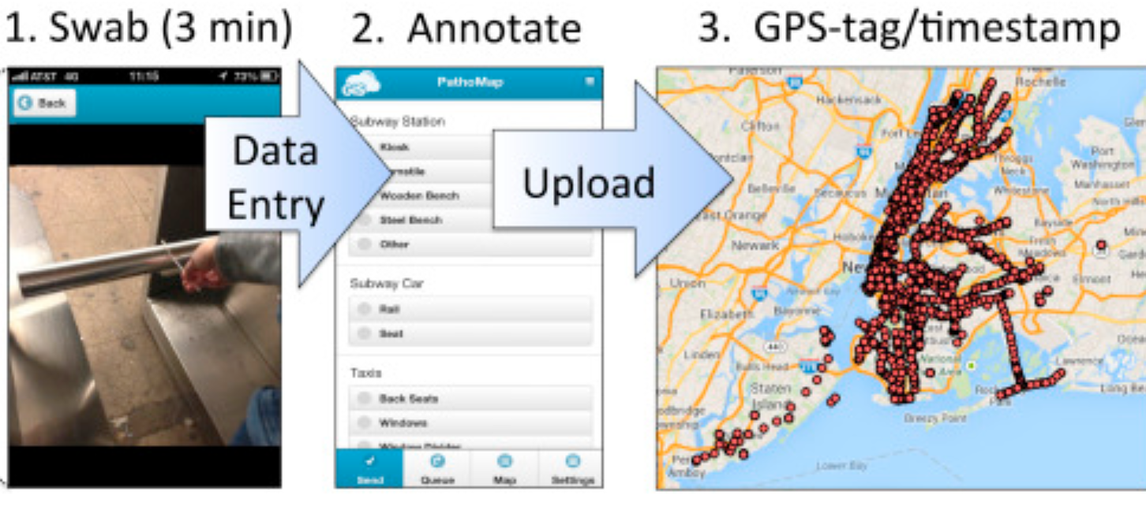
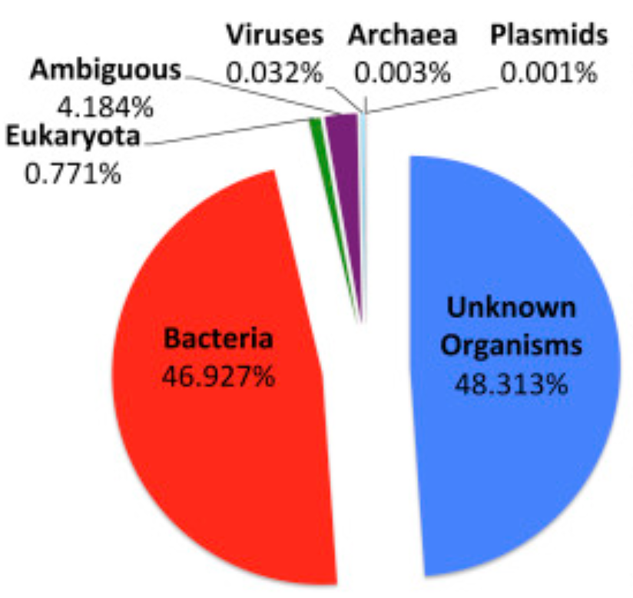
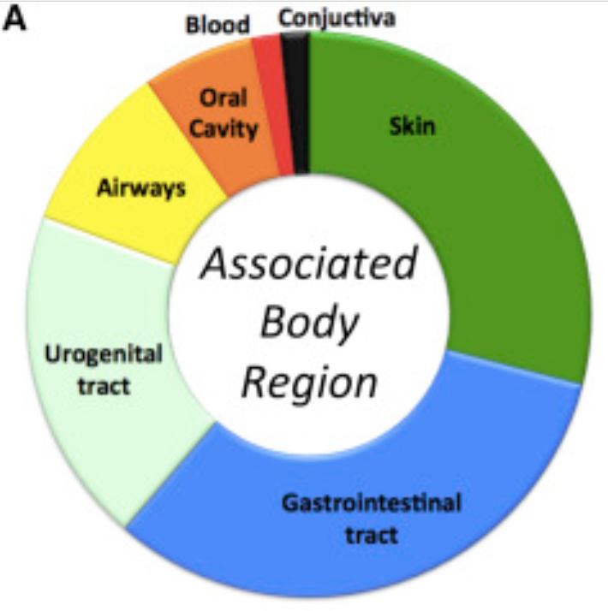
Notes:
Clarify metagenomics here, this is not 16S rRNA sequencing. This is sample, extract DNA
Enterococcus faecium gastrointestinal commensal

Slide 35
Unexpected Result: Evidence of B. anthracis
Gram-positive bacterium that is causative agent of anthrax
Naturally restricted to livestock grazing areas
Bioterrorism threat
Notes:
Endospores are extremely hardy, 2001 Anthrax Attack In 2016, an anthrax outbreak in reindeer was linked to a 75-year-old carcass that defrosted during a heat wave Did a bioterrorism threat go undetected on the most ridden subway system in America? Or, was this a false positive?

Slide 36
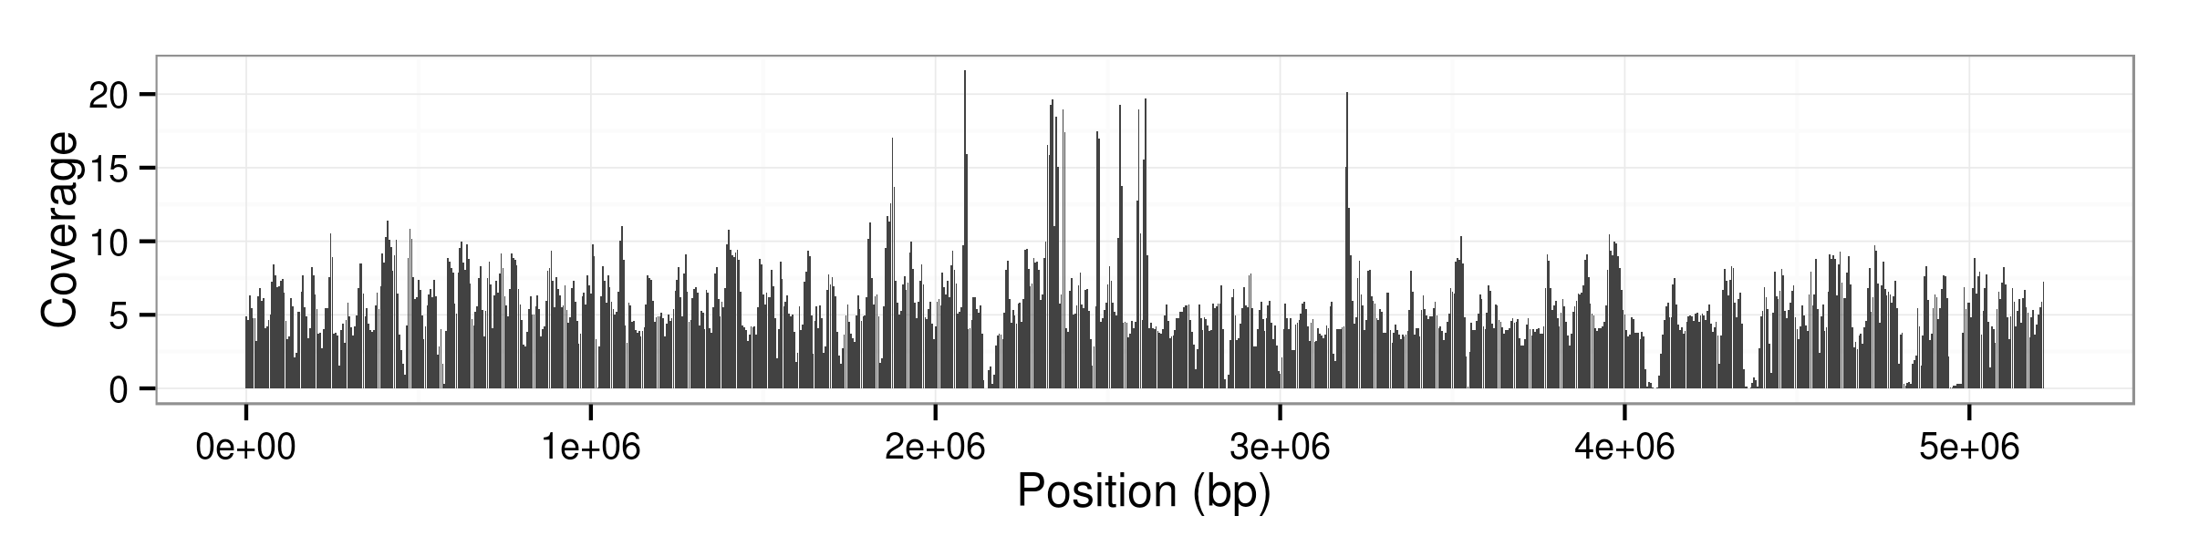
B. anthracis might be present in NYC sample
Mapping against B. anthracis genome
Sure looks like B. anthracis is present…
Notes:
I think we removed ribosomal genes from this sample
Explain this figure in detail, more so how it works, because they will see more
We have short sequences (100bp) and we are mapping them to a reference. So, an algorithm will try to find where a read most accurately maps to. It does this for every read that meets a certain threshold. We can then look at each base in the genome and see how many times it was sequenced

Slide 37
The Bacillus cereus Group (BCG)
Closely related Bacillus species:
B. cereus, B. anthracis, B. thuringiensis, B. mycoides, B. pseudomycoides, B. weihenstephanensis, B. cytotoxicus
High level of synteny and protein similarity at the chromosome level
Plasmids determine pathogenicity and host-specificity
Notes:
Have to consider the background
Hosts: Insects, mammals, and plants - maybe a simple phylogeny

Slide 38
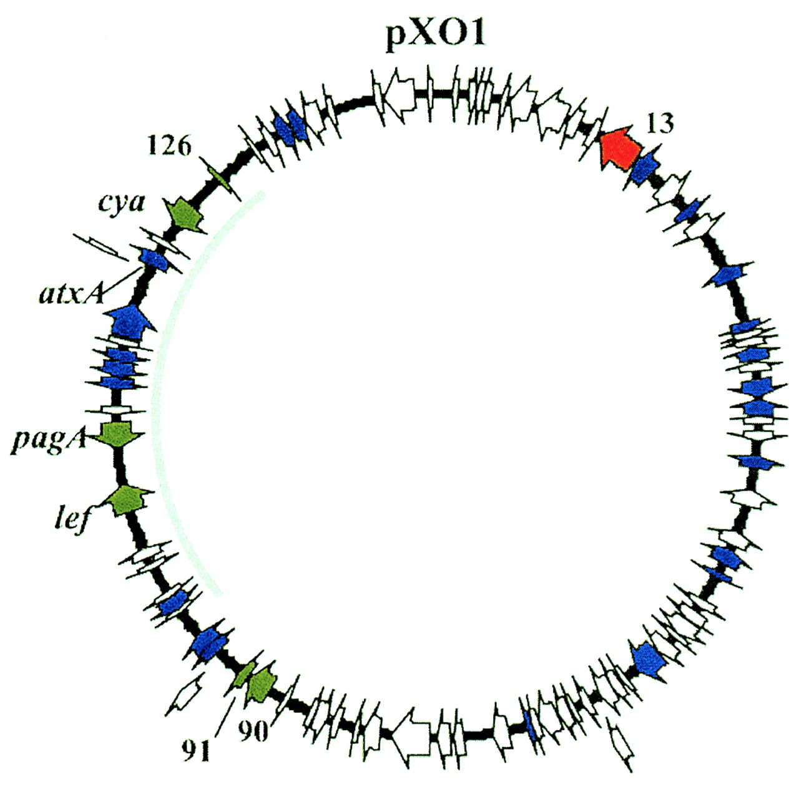
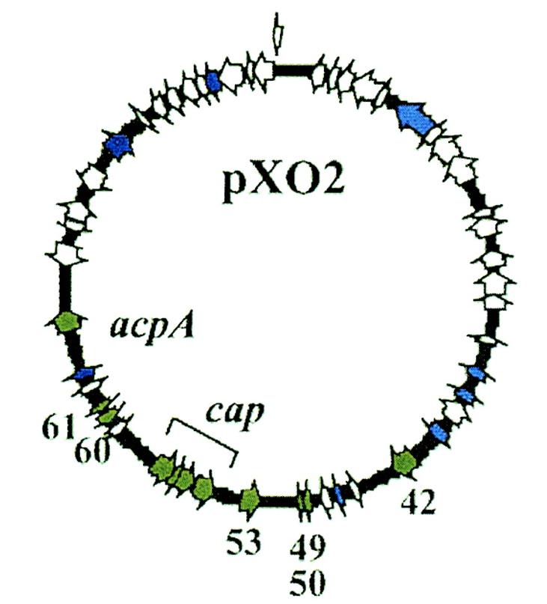
Plasmids pXO1 and pXO2, give B. anthracis its identity
pXO1 encodes the lethal toxin
~180kb
pag - protective antigen
lef - lethal factor
cya - edema factor
pXO2 encodes the capsule
~95kb
Aides in immune evasion
Notes:
pagA, pagR, lef and cya
pXO1 produces the toxin
pag - protective antigen
lef - lethal factor
cya - edema factor
pXO2 produces the capsule (immune evasion)

Slide 39
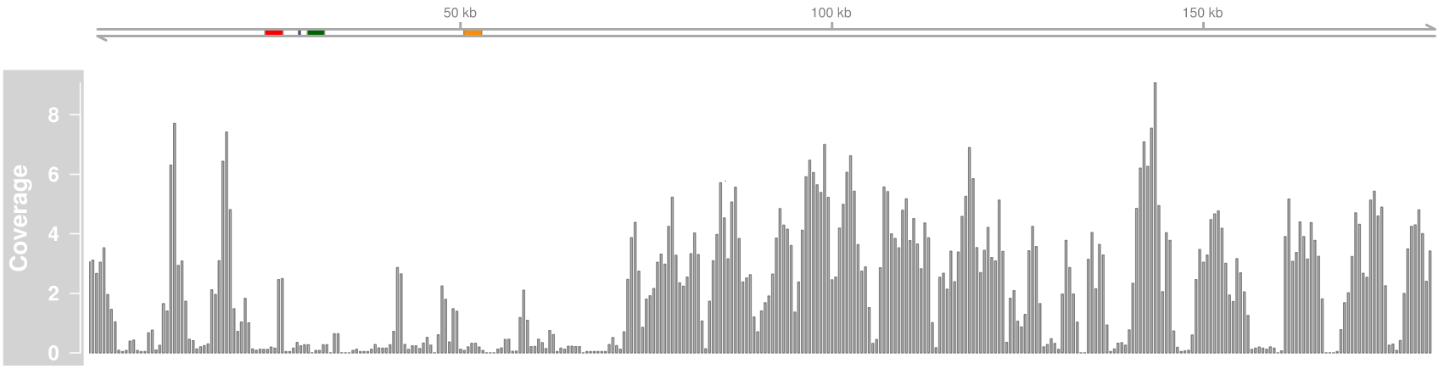
Mapping B. anthracis positive NYC sample to pXO1
Colored regions indicate pag, lef and cya

Slide 40
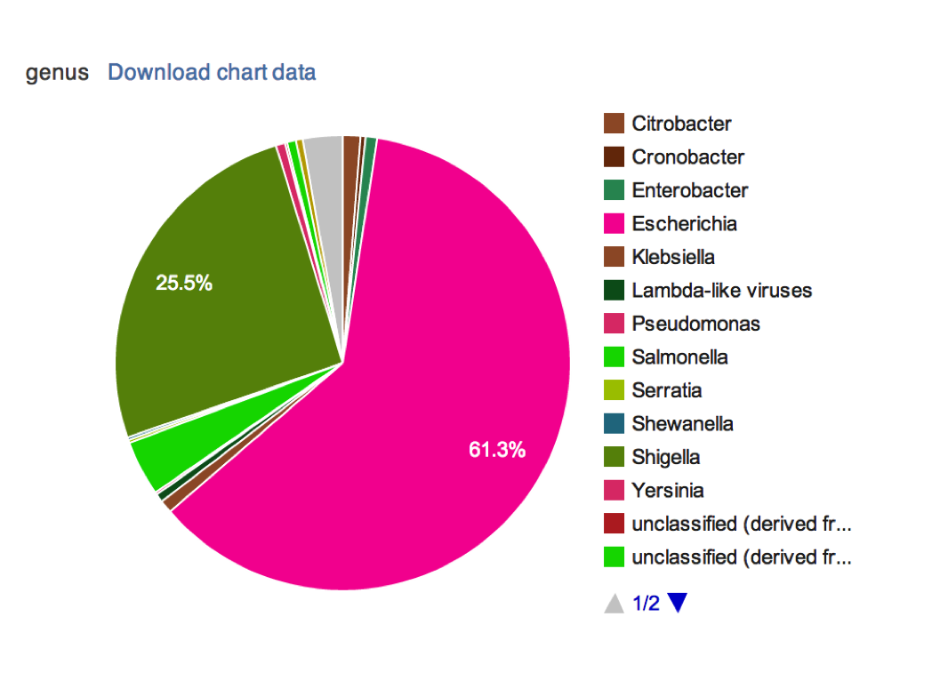
But this was clearly a false positive
No anthrax or bubonic plague symptoms in NYC
If you shred an E. coli genome into 100bp and run metagenomics

Slide 41
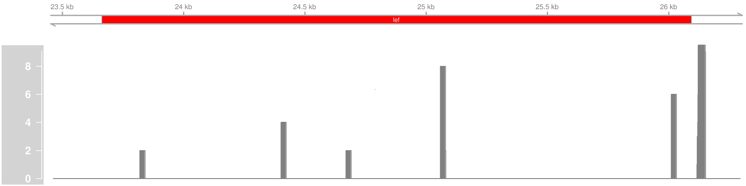
Mapping B. anthracis positive NYC sample to pXO1
Zoomed into the lef region
Notes:
No really much going on, but there are some hits.

Slide 42
“Anthrax” is B. cereus
No evidence for B. anthracis presence
High B. cereus coverage likely ‘fooled’ the metagenome classification software
See this blog post for more details: http://read-lab-confederation.github.io/nyc-subway-anthrax-study/
Notes:
To cut a long story short, In the future, how can we prevent this from happening again?

Slide 43
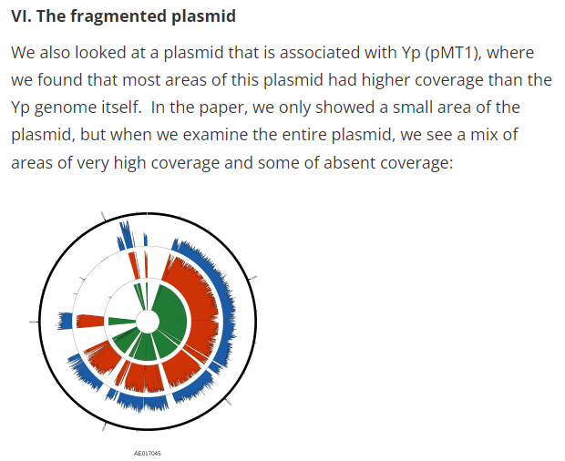
Mason wrote a humbling blog post
Even if you have DNA fragments, and you correctly match it to the right species, and you have evidence that it is coming from a living organism, this still does not mean you have a pathogen.

Slide 44
Cautionary tale
Metagenomics is a good first step
It’s a clue to what’s happening
Be skeptical
Get other lines of evidence
Know your organism. Is its pathogenicity due to a plasmid?
There is a ton more information in Dr. Petit’s presentation and blog post
⚠

Slide 45
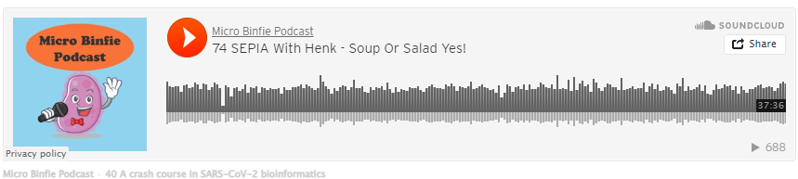
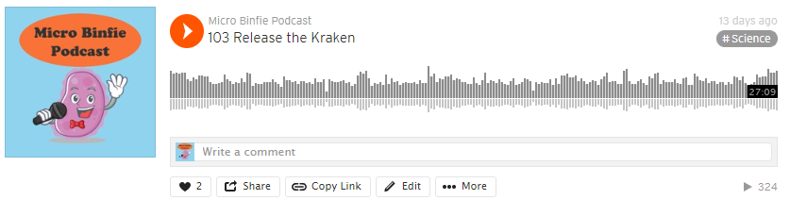
Homework
Go through some metagenomics samples

